Slide 1

A Multi-Module Digital Well-Being and Addiction Risk Management System
22IT703 – PROJECT - I
Domain : AIML

Slide 2
A Multi-Module Digital Well-Being and Addiction Risk Management System
TEAM MEMBERS
HARIHARAN A T – 727722EUIT064
HEDEN JONES A – 727722EUIT066
HELVIN ROSEN A – 727722EUIT067
GUIDED BY
Mr. S Shivashankar
Assistant Professor

Slide 3
OBJECTIVE
To predict the risk level of smartphone addiction among teenagers using machine learning models.
To analyze smartphone usage patterns, lifestyle factors, and psychological indicators to identify normal vs. high-risk users.
To implement and compare three ML algorithms — Decision Tree, Random Forest, and XGBoost — for effective prediction.
To provide the foundation for developing a self-diagnostic application that can help students, parents, and educators monitor and manage smartphone addiction.

Slide 4
PROBLEM DEFINITION
Smartphones have become an essential part of teenagers’ daily life, but excessive usage has led to addiction-like behaviors.
Overuse of smartphones negatively impacts:
Academic performance (reduced concentration, poor grades)
Physical health (sleep deprivation, eye strain, lack of exercise)
Mental health (anxiety, depression, low self-esteem)
Social relationships (reduced family interaction, isolation)
Existing methods to detect smartphone addiction rely mostly on self-reported surveys, which are subjective and time-consuming.
There is a need for an automated, data-driven system that can analyze smartphone usage patterns and predict addiction risk accurately.

Slide 5
EXISTING SYSTEM
Google Digital Wellbeing : Pre-installed on Android devices. Tracks screen time, app usage, and notifications. Helps set app timers and “Focus Mode”.
Apple Screen : Time Built into iOS devices. Shows daily/weekly usage reports, app limits, downtime scheduling.
Forest (Stay Focused App) Gamified productivity app. Encourages users to avoid phone usage by “growing a tree” while staying focused.

Slide 6
DISADVANTAGES OF EXISTING SYSTEM
Survey-Based Assessments : (e.g., Smartphone Addiction Scale – SAS)Subjective rely on self-reported answers (users may lie or misjudge).Time-consuming: need to fill long questionnaires. Cannot give real-time prediction.
Digital Wellbeing & Screen Time Apps (Google, Apple, QualityTime, Moment) : Only provide descriptive statistics (hours used, app usage).No risk classification (Normal vs. High-risk).No predictive analytics to warn before addiction develops.
Gamified Focus Apps (Forest, Stay Focused) : Encourage reduced usage but do not analyze addiction patterns.Work as behavioral nudges, not diagnostic tools.

Slide 7
PROPOSED SYSTEM
ML-Based Prediction
Develop a machine learning model (Sand-Cat Optimization , Grey-Wolf Optimization , Bi-LSTM) to predict smartphone addiction risk among teenagers.
Feature-Driven Analysis
Use smartphone usage patterns, lifestyle, and psychological factors as input features to classify users into Normal or High-Risk groups.
Practical Application
Provide the foundation for a self-diagnostic application that can help students, parents, and educators monitor and manage smartphone addiction.

Slide 8
ADVANTAGES OF PROPOSED SYSTEM
Objective & Accurate :
Uses machine learning models for prediction, reducing subjective bias from self-reported surveys.
Predictive Capability :
Not just descriptive like existing apps — provides risk classification (Normal vs. High-Risk).
Practical & Scalable :
Can be deployed as a self-diagnostic app, making it accessible to students, parents, and educators.

Slide 9
LITERATURE SURVEY
References Title | Authors | Feature Extraction Methodology | Datasets | Demerits
The conceptualization and assessment of problematic mobile phone use | Lopez Fernandez, Olatz | Self-Report Questionnaires: Frequency of use, Emotional dependance, Withdrawal symptoms, Functional impairment | Clinical Populations, Online Panels | Self Report Bias, Cultural Bias, Overlapping Constructs
Cell-Phone Addiction: A Review | José De-Sola Gutiérrez, Fernando Rodríguez de Fonseca | Metadata Features Usage Logs, Self Reported Surveys, Sensor data, textual data | Global Mobile Phone addiction dataset | Data privacy and ethical concerns, Psychological impact of misclassification

Slide 10
SYSTEM REQUIREMENTS
HARDWARE REQUIREMENT
PROCESSOR : Intel i5 or higher
SPEED : 2.4 GHz or above
RAM : 8 GB minimum
SOFTWARE REQUIREMENT
OPERATING SYSTEM : Windows / Linux / macOS
FRONT END : React.js / HTML, CSS, JS
LANGUAGE : Python with Flask or FastAPI and with all Necessary Modules
TOOLS : Postman, VS Code, GitHub

Slide 11
SYSTEM ARCHITECTURE
Input Layer (Data Collection):
Smartphone addiction datasets (Kaggle, surveys, logs).
Preprocessing Layer
Data cleaning (removing irrelevant fields like ID, Name).
Encoding categorical features (Gender, Grade, Usage Purpose).
Normalizing numerical features (usage hours, sleep, anxiety, etc.).
Model Training Layer Machine Learning models:
Sand-Cat Optimization , Grey-Wolf Optimization , Bi-LSTM .
Evaluation Layer
Accuracy, Precision, Recall, F1-score, Confusion Matrix.
Prediction Layer
Classify user as Normal (0) or High-Risk (1).
Provide results for new inputs.

Slide 12
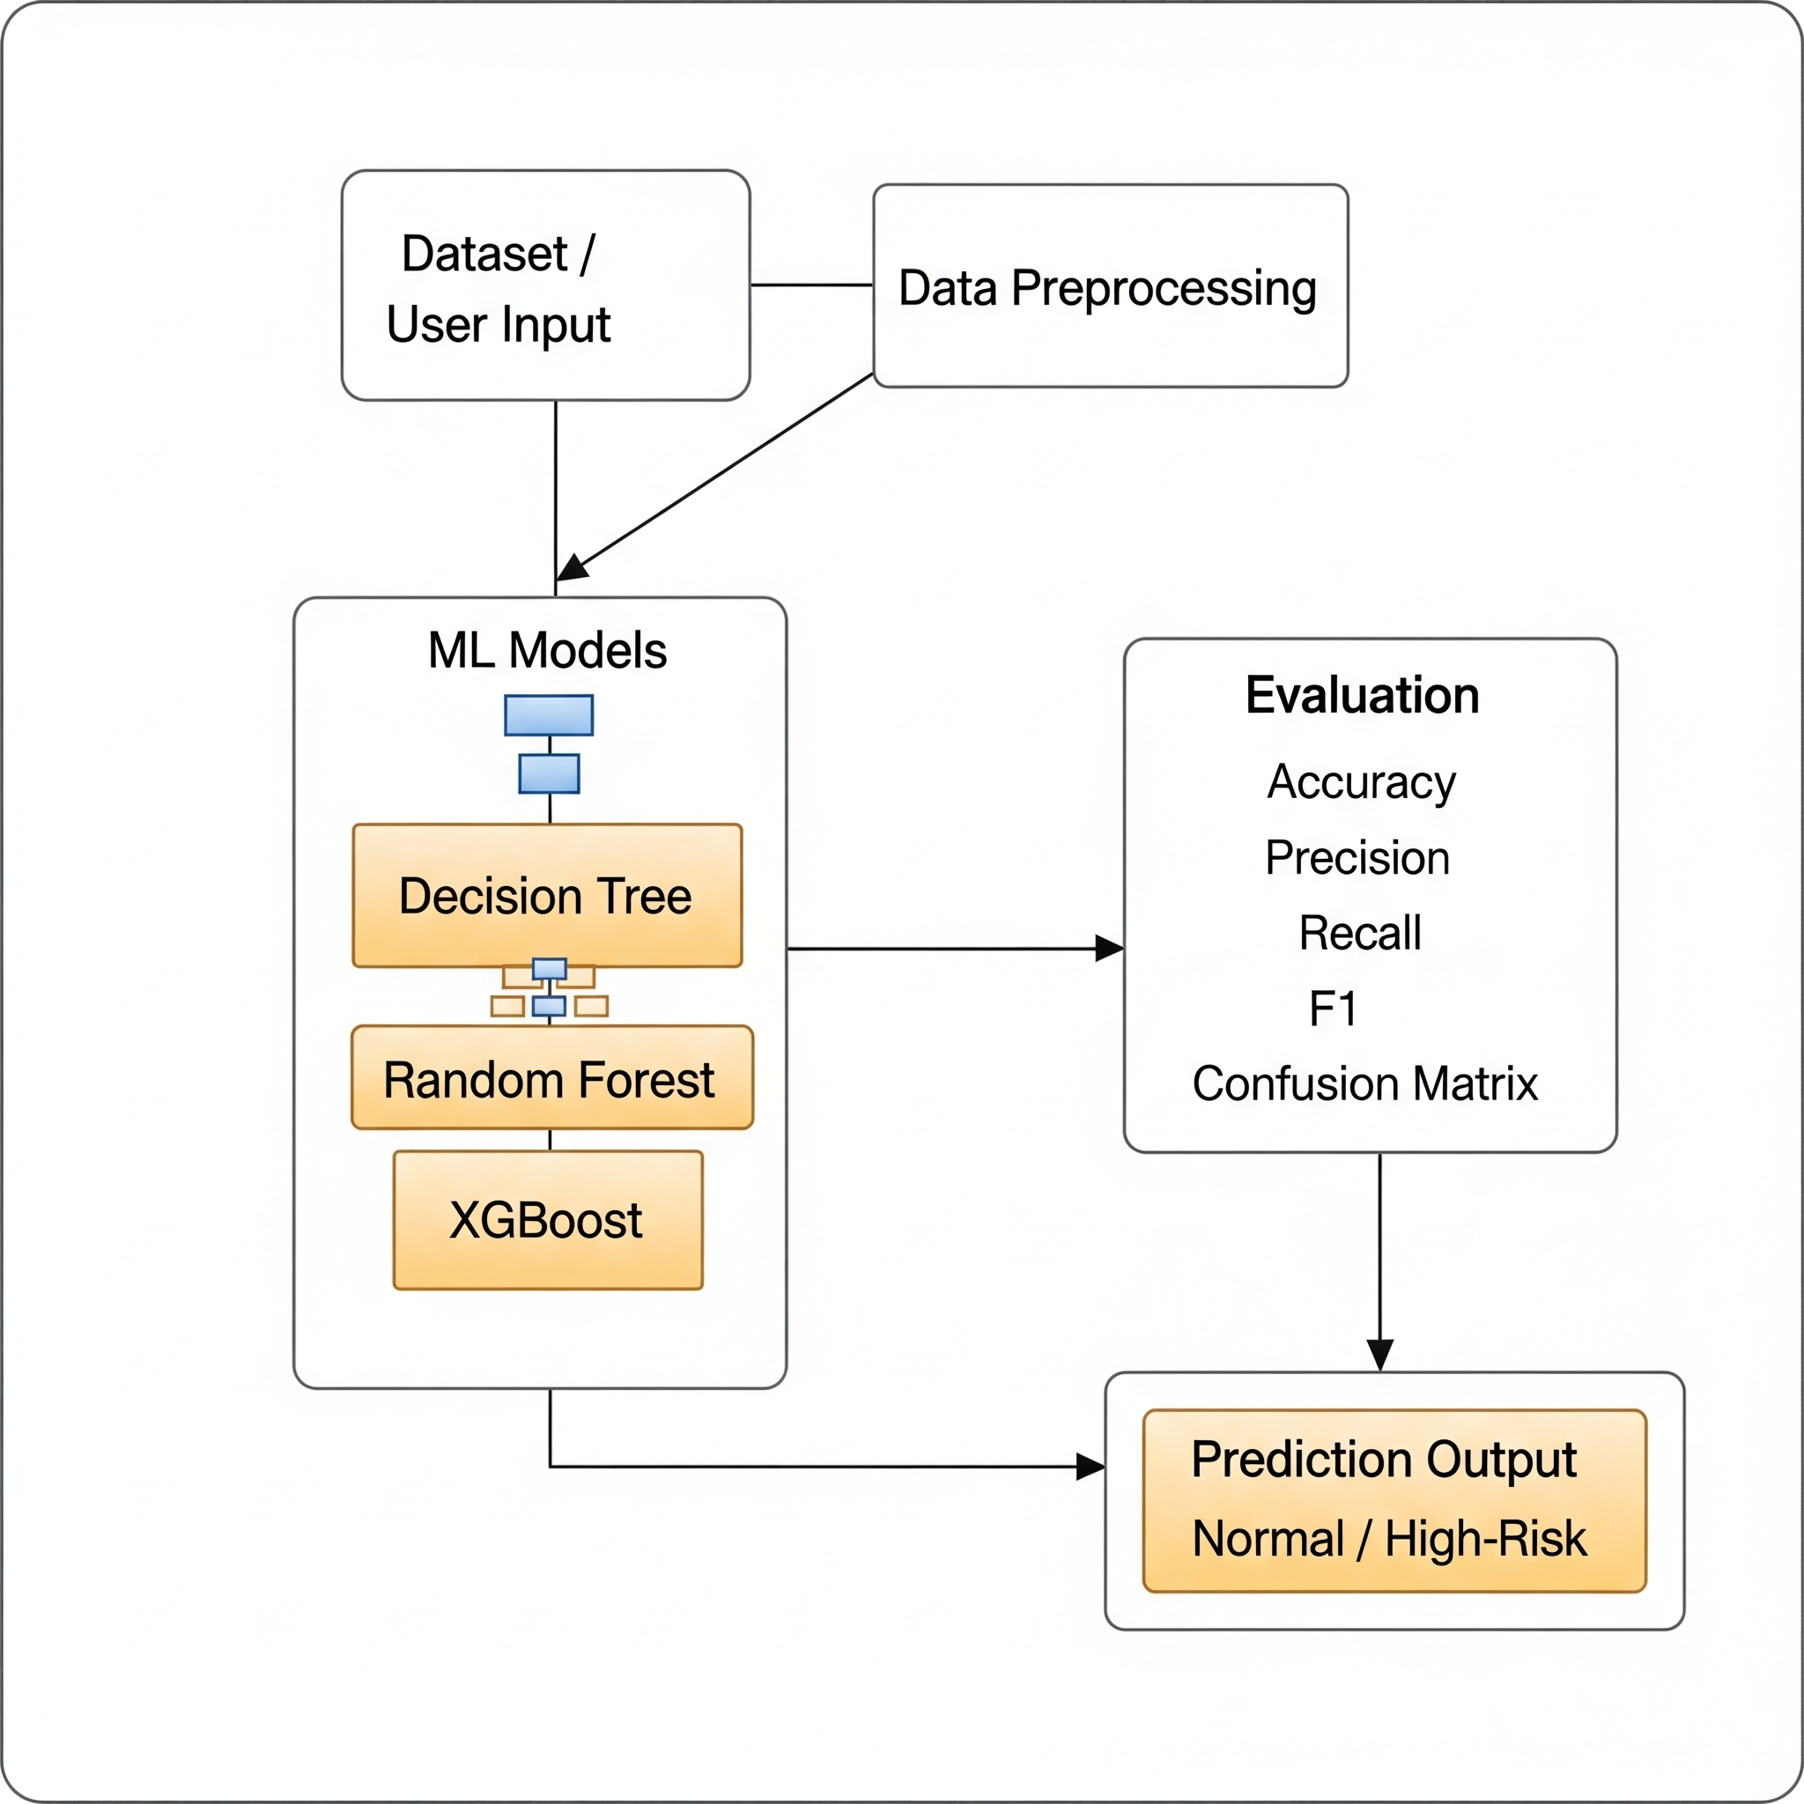
DATA FLOW DIAGRAM

Slide 13
MODULES
Data Collection Module
2. Data Preprocessing Module
3. Feature Selection & Transformation Module
4. Model Training & Tuning Module
5. Evaluation Module
6. Prediction Module

Slide 14
MODULE DESCRIPTION
Data Collection Module
Collects raw data from Kaggle datasets, surveys, or smartphone usage logs.
Includes attributes like daily usage hours, sleep patterns, academic performance, social interaction, and psychological factors.
Data Preprocessing Module
Cleans and formats the dataset (removes duplicates, missing values, irrelevant fields).
Encodes categorical variables (e.g., Gender, Usage Purpose).
Normalizes numerical values (e.g., usage hours, anxiety levels) for uniform scaling.
Model Training & Tuning Module
Trains multiple ML algorithms (SCO & Grey-Wolf Optimization , Bi-LSTM ).
Applies Grid Search CV for hyperparameter optimization.
Selects the best-performing model for prediction.

Slide 15
MODULE DESCRIPTION
Evaluation Module
Assesses model performance using Accuracy, Precision, Recall, F1-Score, and Confusion Matrix.
Helps compare models to choose the most reliable one.
Prediction Module
Takes new user input (age, usage hours, academic performance, etc.).
predicts the risk level: Normal User (0) or High-Risk User (1).
Application Module (Future Scope)
Provides a user interface via React.js frontend and Flask/FastAPI backend.
Offers easy access for students, parents, and educators to monitor smartphone addiction risk.

Slide 16
CONCLUSION
The proposed system applies machine learning techniques (Sand-Cat Optimization , Grey-Wolf Optimization , Bi-LSTM) to predict smartphone addiction risk among teenagers.
By analyzing behavioral, lifestyle, and psychological factors, the model can effectively classify users as Normal or High-Risk.
This system overcomes the limitations of existing survey-based apps by offering an objective, accurate, and scalable solution.
In the future, the model can be integrated into a web or mobile application to help students, parents, and educators monitor and manage smartphone addiction.

Slide 17
FUTURE ENHANCEMENT
Larger & Real-Time Datasets
Integrate data from multiple sources (smartphone usage logs, IoT, surveys) for higher accuracy.
Personalized Recommendations
Provide suggestions & alerts (e.g., screen time reduction tips, study reminders, relaxation exercises).
Integration with Healthcare Systems
Share reports with parents, teachers, or counsellors for better intervention and support.
Mobile / Web Application Deployment
Develop a user-friendly app (React + Flask/FastAPI) for real-time addiction risk assessment.

Slide 18
REFERENCES
[1] M. Dave, K. Patel, “Smartphone Addiction Prediction Using Machine Learning Techniques,” International Journal of Advanced Computer Science and Applications (IJACSA), vol. 13, no. 5, pp. 123–130, 2022.
[2] N. Sharma, R. Verma, “Machine Learning Models for Predicting Smartphone Usage Patterns among Teenagers,” Journal of Information and Communication Technology Research, vol. 11, no. 2, pp. 87–95, 2023.

Slide 19
THANK YOU

